Slide 1

“Finding influencers in social networks” minor project MID-TERM PRESENTATION
Project Guide- Mr. Jaya Krishna
Presented By- Syed Ali 169108149
Rishabh Makhija 169108116

Slide 2
CONTENTS
Aim of the project
Motivation
Social networks
Centrality methods
Combining local and global measures
Performing on sawmill data set and analysis
Triadic influence in a social network
Stability in the structure of a relationship
Triadic closure and types of triads
Use of machine learning
Extracting triads and detecting influence in a network
Gantt chart
Work to be done
References

Slide 3

AIM OF THE PROJECT
To establish a comparative study on which method can best be used to detect influencers in a social network.
Fig: 1

Slide 4
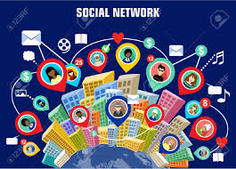
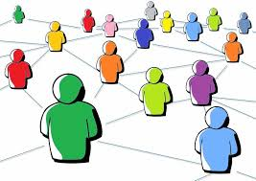
SOCIAL NETWORKS
Fig: 2
Fig: 3

Slide 5
MOTIVATION
The widespread adoption of social media as means for expressing, sharing and challenging opinions.
Interest of identifying influential users, which could help various organizations in enhancing the reputation of their products, services and public image in general.
Powers of an influencer-
Wide and loyal audience
Credibility
Content

Slide 6
CENTRALITY METHODS
Local centrality deals with the neighboring nodes whereas global centrality deals with the entire graph.
Local centrality:
Degree Centrality
K-shell Decomposition
Global Centrality:
Betweenness Centrality
Closeness Centrality

Slide 7
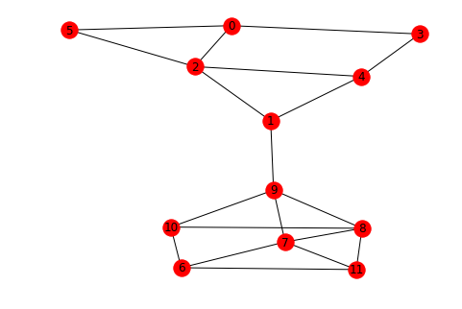

DEGREE CENTRALITY
Degree of 2: 4
Degree of 5: 2
Degree Centrality: $\frac{Degree}{no. of nodes −1}$
Fig: 4

Slide 8
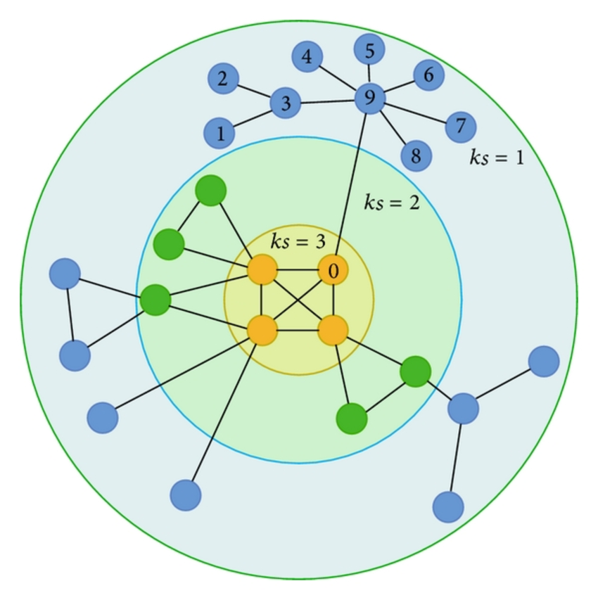
K-SHELL DECOMPOSITION
Same Degree nodes.
Importance to core.
Fig: 5

Slide 9
K-SHELL DECOMPOSITION ALGORITHM
Step 1: Selecting nodes with degree ‘1’, removing them from the network and adding them to an array
Step 2: Check for nodes with degree ‘1’ after removal and add it the same array
Step 3: Keep on increasing the degree values until all the nodes are classified into a group.

Slide 10
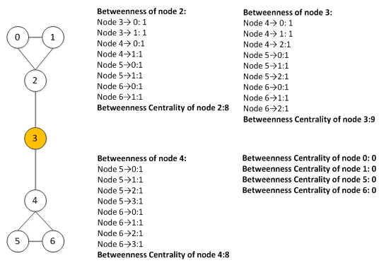
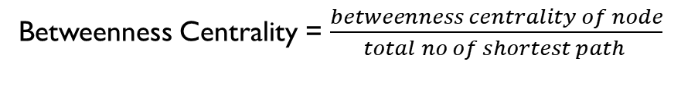
BETWEENNESS CENTRALITY
Betweenness Centrality = $\frac{betweenness centrality of node}{total no of shortest path }$
Fig: 6

Slide 11
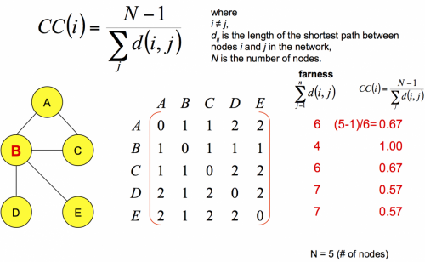
CLOSENESS CENTRALITY
Fig: 7

Slide 12
COMBINING LOCAL AND GLOBAL MEASURES
Need for it:
Local Centrality methods are easy to calculate but these might not be precise.
Global centrality methods are precise but are time consuming.
Combining:
Performing k-shell decomposition for the graph.
Removing other nodes which are not a part of the core network.
Performing Centrality measures to determine the influential node.

Slide 13
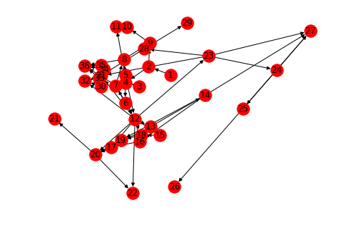
PERFORMING ON SAWMILL DATA SET
import networkx as nx
import matplotlib.pyplot as plt
my_graph = nx.Graph()
A=nx.read_pajek('Sawmill.net')
A=nx.convert_node_labels_to_integers(A,first_label=1)
nx.draw(A,with_labels=True)
plt.show()
Fig: 8

Slide 14
ANALYSIS (BEFORE REMOVING)
 | Before Removing
Nodes | Degree | betweeness centrality | Closeness Centrality
1 | 1 | 0 | 0
2 | 3 | 0 | 0.028571429
3 | 1 | 0 | 0
4 | 4 | 0.083193277 | 0.064285714
5 | 5 | 0.039327731 | 0.057142857
6 | 3 | 0 | 0.054945055
7 | 5 | 0.037815126 | 0.093506493
8 | 4 | 0 | 0.0875
9 | 3 | 0.004537815 | 0.101587302
10 | 2 | 0.004537815 | 0.085714285
11 | 2 | 0 | 0.102040816
12 | 13 | 0.063529412 | 0.093333333
13 | 4 | 0.00605042 | 0.079503106
14 | 4 | 0 | 0.072321429
15 | 2 | 0 | 0.079503106
16 | 4 | 0.00302521 | 0.114285714
17 | 3 | 0.00907563 | 0.123469388
18 | 3 | 0.00605042 | 0.096428571
19 | 3 | 0 | 0.111196911
20 | 6 | 0.01210084 | 0.183673469
21 | 1 | 0 | 0.143417367
22 | 2 | 0 | 0.170099668
23 | 5 | 0.036302521 | 0.079503105
24 | 3 | 0.01210084 | 0.072321429
25 | 3 | 0.00605042 | 0.068027211
26 | 1 | 0 | 0.06522911
27 | 4 | 0 | 0.130501931
28 | 3 | 0.00605042 | 0.072321429
29 | 1 | 0 | 0.068027211
30 | 2 | 0 | 0
31 | 7 | 0.011092437 | 0.132967033
32 | 4 | 0.004033613 | 0.141871921
33 | 3 | 0.003529412 | 0.123809524
34 | 2 | 0 | 0
35 | 3 | 0.002521008 | 0.123809524
36 | 5 | 0 | 0.223166023
Table: 1

Slide 15
ANALYSIS (AFTER REMOVING)
 | After K-shell Removal
Nodes | degree | betweenness centrality | closeness centrality
1 | removed | removed | removed
2 | removed | removed | removed
3 | removed | removed | removed
4 | removed | removed | removed
5 | 3 | 0 | 0
6 | 3 | 0.009848485 | 0.083333333
7 | 4 | 0.019696969 | 0.111111111
8 | 3 | 0.009848485 | 0.1875
9 | removed | removed | removed
10 | removed | removed | removed
11 | removed | removed | removed
12 | 9 | 0.206818182 | 0.25
13 | 3 | 0 | 0.19047619
14 | removed | removed | removed
15 | removed | removed | removed
16 | 3 | 0 | 0.260416667
17 | 3 | 0.009848484 | 0.3
18 | removed | removed | removed
19 | removed | removed | removed
20 | 3 | 0 | 0.371212121
21 | removed | removed | removed
22 | removed | removed | removed
23 | removed | removed | removed
24 | removed | removed | removed
25 | removed | removed | removed
26 | removed | removed | removed
27 | removed | removed | removed
28 | removed | removed | removed
29 | removed | removed | removed
30 | removed | removed | removed
31 | 3 | 0.024621212 | 0.19047619
32 | 3 | 0.024621212 | 0.260416667
33 | 3 | 0.01969697 | 0.23076923
34 | removed | removed | removed
35 | removed | removed | removed
36 | 3 | 0 | 0.380952381
Table: 2

Slide 16
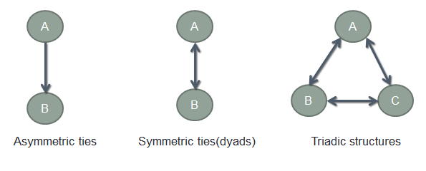
TRIADIC INFLUENCE IN A SOCIAL NETWORK
Social influence occurs when one’s opinions, emotions, or behaviors are affected by others.[1]
We study social influence from a structure level, focusing on the triadic structure as is the simplest group structure in social networks as well as the cornerstone for studying network formation. [2]
Fig: 9

Slide 17
TRIADIC CLOSURE
Triadic closure is the property among three nodes A, B, and C, such that if a strong tie exists between A-B and A-C, there is a weak or strong tie between B-C.
Too extreme to hold true across complex networks
The transitive property.
Feedback and conflict-resolving property.
A
B
C
Fig: 10

Slide 18
USE OF MACHINE LEARNING
In the referred paper,[3] the authors used triadic features from their dataset and did an OLS analysis on it.
Dataset used- weibo.com [4]
Methods implemented- Logistic regression & KNN
Inference- It was observed that both the algorithms classify the dataset fairly well, but KNN algorithm seems to give better results when the value of k is varied.

Slide 19
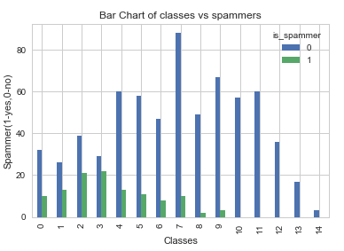
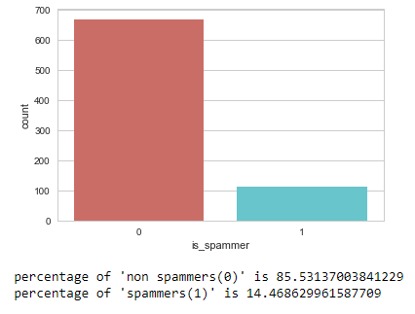
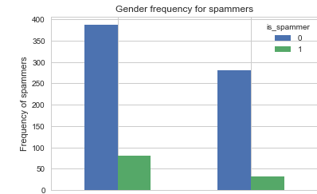
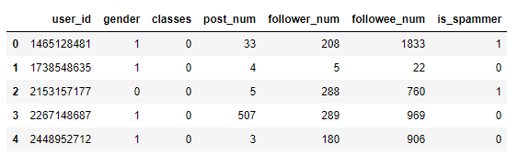
ANALYSIS
Female
Male

Slide 20
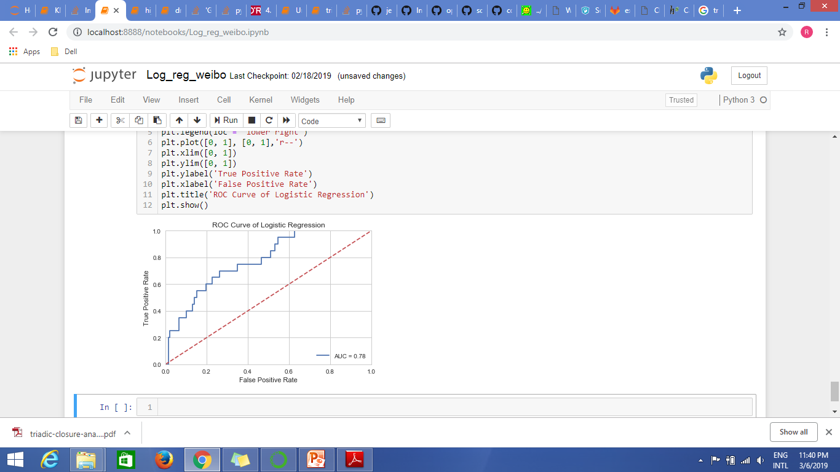
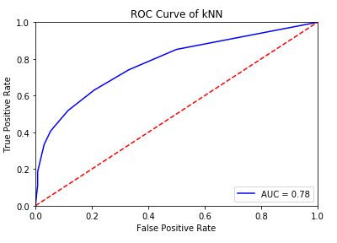
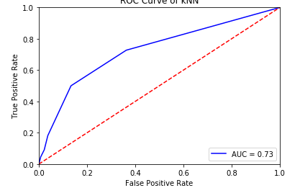
IMPLEMENTATION
Features- gender, classes, post_num, followee_num
135
2
17
3
K=10
Confusion matrix for Logistic Regression
132
6
14
5
138
2
14
3
K=5
K=5
Confusion matrix for KNN
K=10

Slide 21
EXTRACTING TRIADS AND DETECTING INFLUENCERS
Triadic structures are also present in terrorist networks.
Dataset used- 9/11 hijackers’ network
Method implemented- Triadic closure analysis.
FROM | TO | STRENGTH | VERIFIED
David Courtaillier | Zacarias Moussaoui | 5 | 1
David Courtaillier | Jerome Courtaillier | 5 | 1
Ahmed Ressam | Zacarias Moussaoui | 5 | 1
Hani Hanjour | Majed Moqed | 1 | 2
Hani Hanjour | Nawaf Alhazmi | 1 | 2

Slide 22
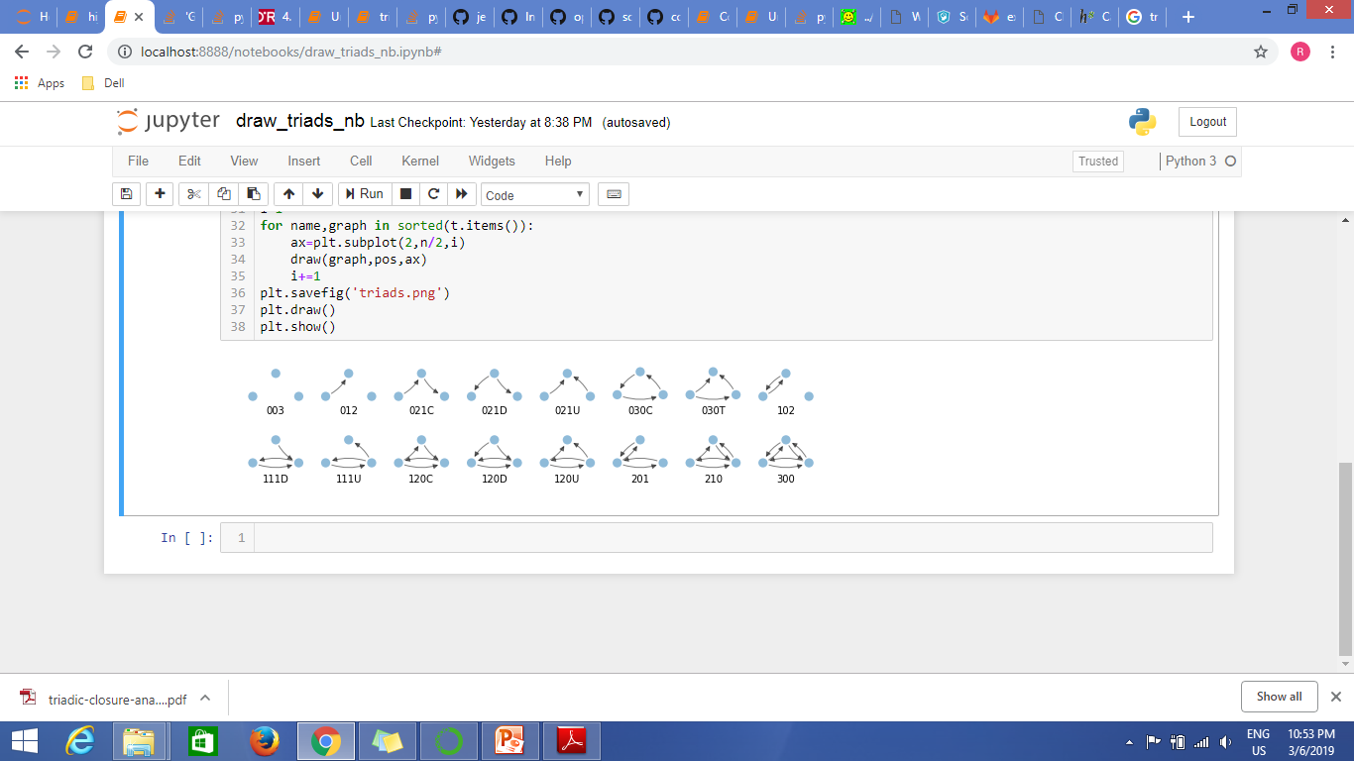
TYPES OF TRIADS
16 different types of triads
Directed triads
Fig: 11

Slide 23
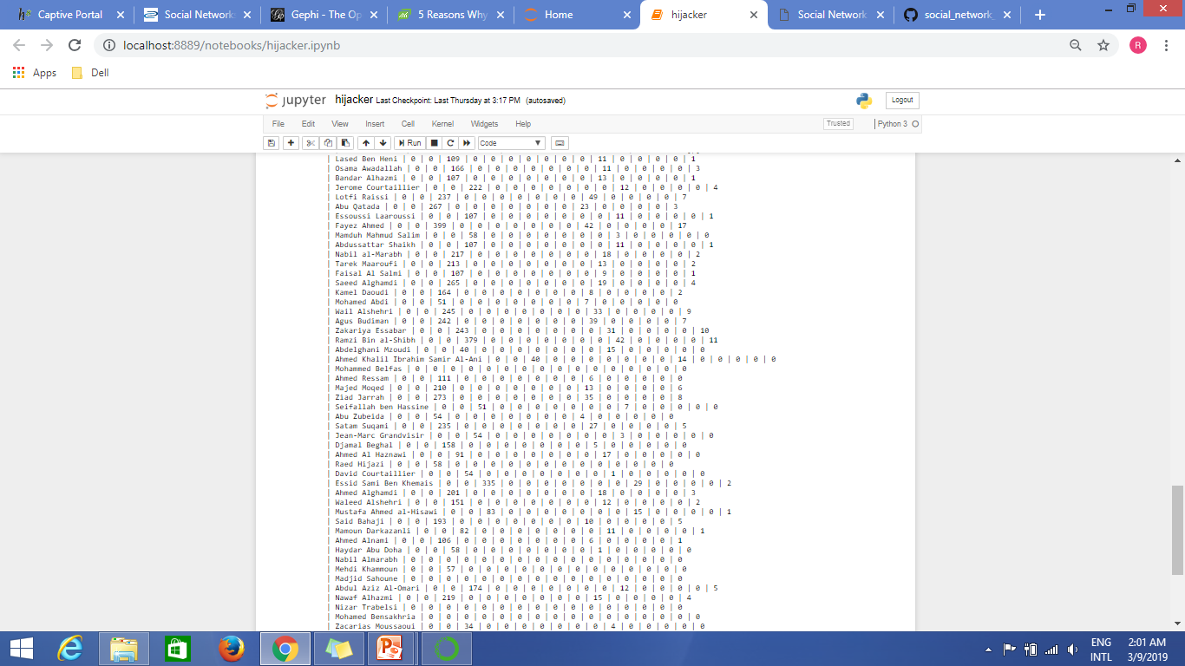
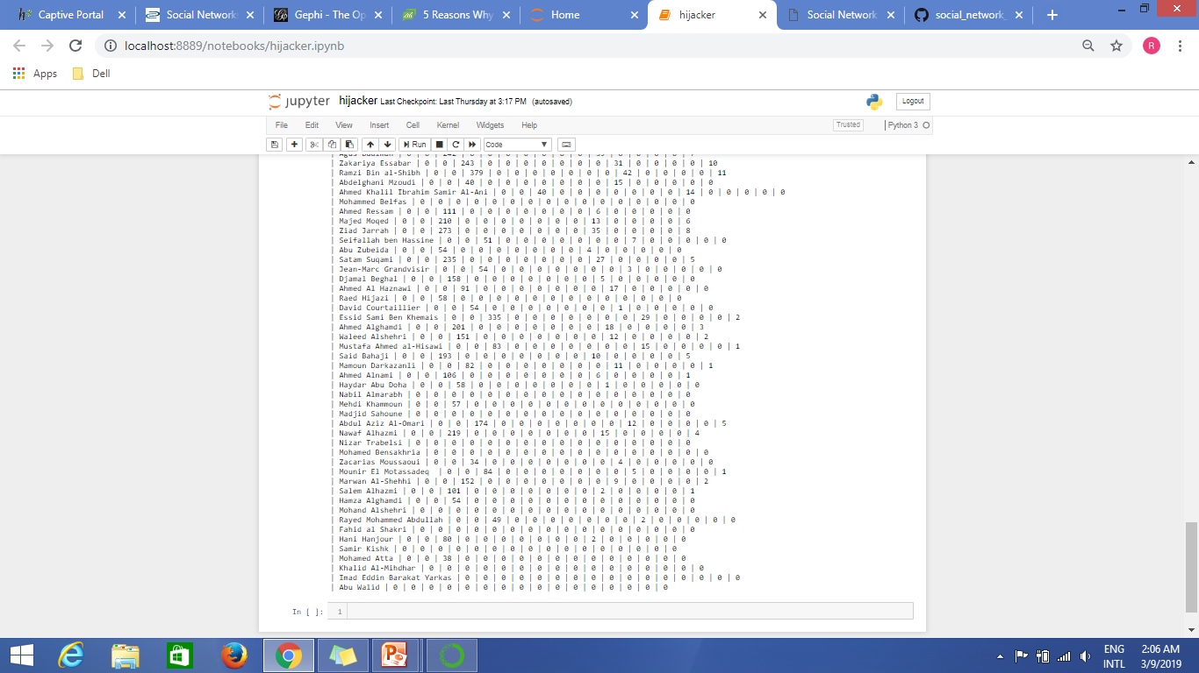
Node | 003 | 012 | 102 | 021D | 021U | 021C | 111D | 111U | 030T | 030C | 201 | 120D | 120U | 120C | 210 | 300

Slide 24
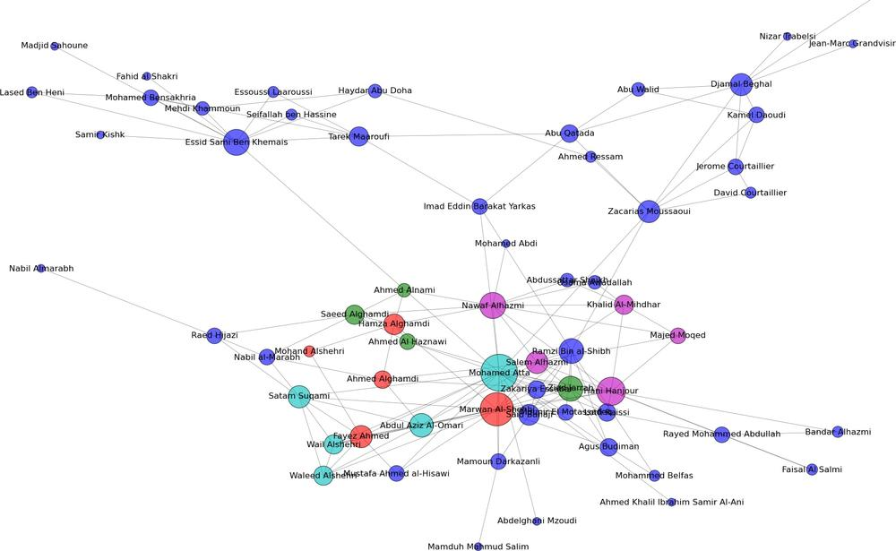
NETWORK GRAPH OF 9/11 HIJACKERS [5]
None- blue ; 175_WTC_South-green; 93_Penn-red; 11_WTC_North-cyan; 77_Pentagon-magenta

Slide 25
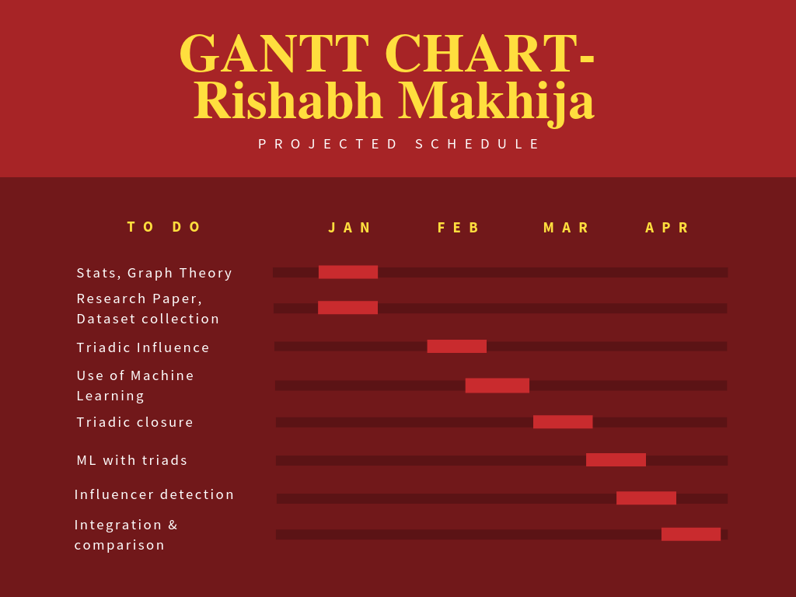

Slide 26
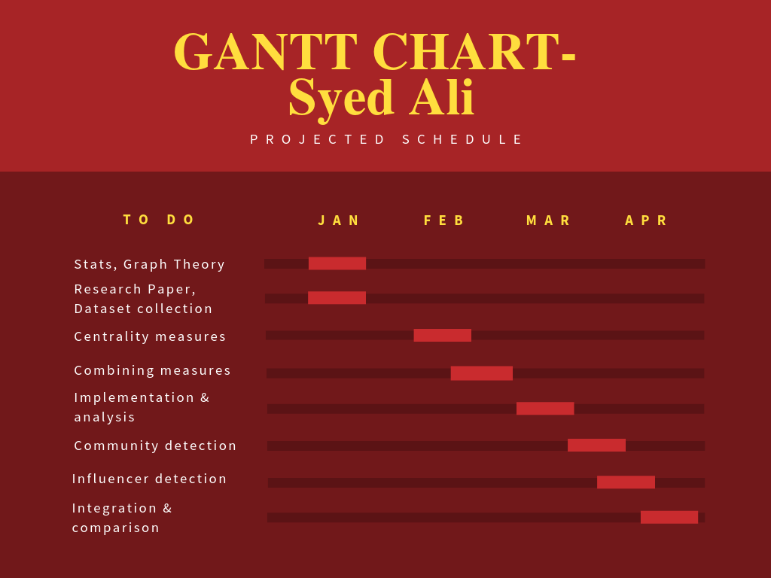

Slide 27
WORK TO BE DONE
Community detection in the network.
To use triadic features from the datasets and implement ML algorithms to detect influential nodes
Use of larger datasets
Integration and comparison of centrality methods

Slide 28
REFERENCES
[1] M. Deutsch & H. B. Gerard, “A study of normative and informational social influences upon individual judgment,” Journal of Abnormal and Social Psychology, vol. 51, pp. 629–636, 1955.
[2] H. Huang, J. Tang, L. Liu, J. Luo & X. Fu, “Triadic closure pattern analysis and prediction in social networks,” IEEE TKDE, vol. 27, pp. 3374–3389, 2015.
[3] C. Zhang, S. Gao, J. Tang(2016). “Learning triadic influence in large social networks.” IEEE/ACM International Conference on ASONAM
[4] https://archive.ics.uci.edu/ml/datasets/microblogPCU - MicroblogPCU data is crawled from sina weibo microblog
[5] M. Tsvetovat, A. Kouznetsov(2011). “Social network analysis for startups”
[6] Fig: 1,2,3,5,6,7, Google images.

